Slide 1
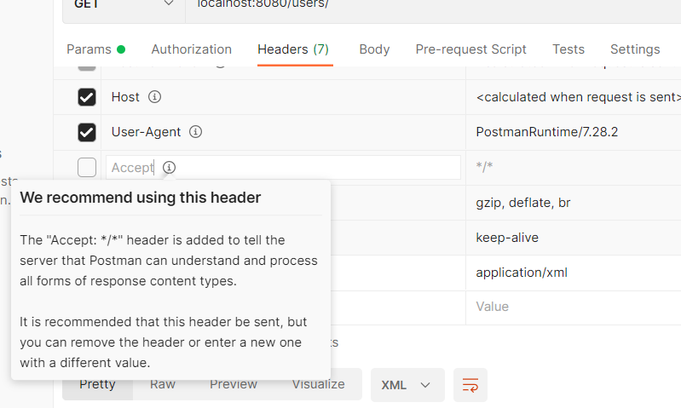
CONTENT NEGOTIATION
We can specify what kind of content is retured as Output by our API.
Usually its JSON by default, but we will try to return here an XML instead.
We will try to modify Accept header in the request by changing it to application/xml instead. Also we need to add some dependency for same .

Slide 2
Added dependency in POM.XML
<!--Content Negotiation -->
<dependency>
<groupId>com.fasterxml.jackson.dataformat</groupId>
<artifactId>jackson-dataformat-xml</artifactId>
</dependency>

Slide 3
